Slide 1
Build a Cloud-based Temperature Monitoring system IOT using Spartan3an Starter Kit
Submitted in the partial fulfillment for the award of the degree of
BACHELOR OF ENGINEERING
IN
COMPUTER SCIENCE WITH SPECIALIZATION IN
DevOps
DevOps
Submitted by:
Hitashi(22BDO10039)
Km Ayushi(22BDO10055)
Under the Supervision of:
Ms Geetanjali Pandey
Department of AIT-CSE
DISCOVER . LEARN . EMPOWER

Slide 2
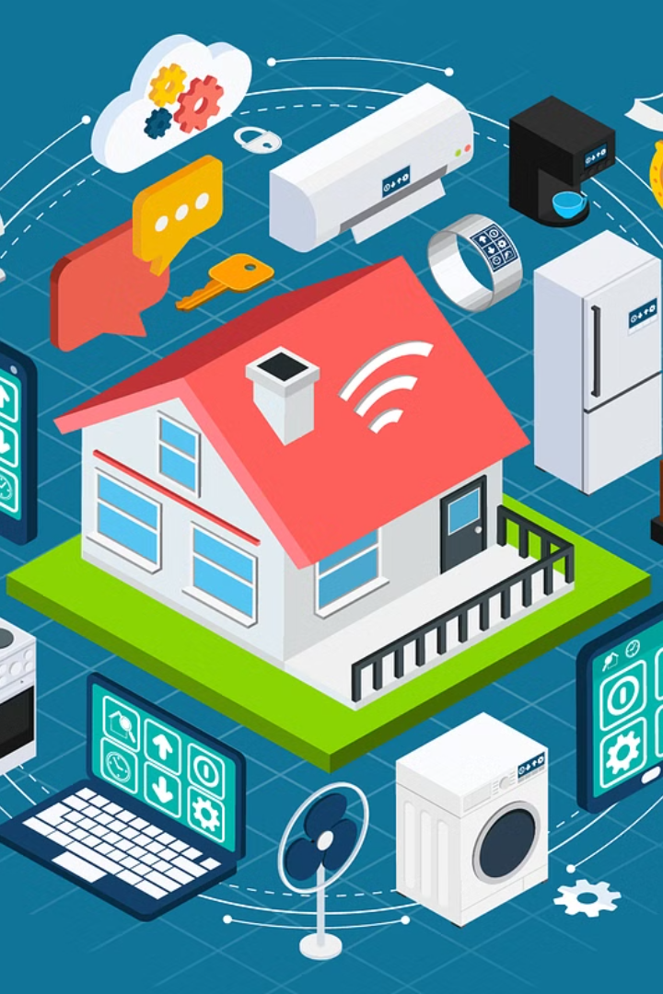
Introduction to Project
The emergence of Internet of Things (IoT) technologies has brought about a significant transformation across various sectors, facilitating effortless connectivity and data exchange between physical devices and the virtual world. One of the most notable advancements has been the integration of IoT with Field Programmable Gate Arrays (FPGAs), which has opened up a whole new realm of possibilities for developing adaptive and highly efficient embedded systems. In this paper, we introduce a pioneering approach to creating a Cloud-based temperature monitoring system using the Spartan3AN FPGA starter kit.

Slide 3
Problem Formulation
1
Optimizing FPGA-based Implementation
Developing a cloud-based temperature monitoring system using the Spartan3AN Starter Kit for IoT applications requires addressing several key challenges. These challenges include optimizing the FPGA-based implementation for efficient sensor data processing.
2
Seamless Integration with Cloud Services
Ensuring seamless integration with cloud services for data storage and analysis is a crucial aspect of developing the temperature monitoring system.
3
Addressing Security Concerns
The main objective of this study is to devise an effective solution that maintains a balance between performance, scalability, and security to enable real-time temperature monitoring in various IoT environments.

Slide 4
Objectives of the Work
Robust Cloud-based System
FPGA-based Integration
Cloud Services Integration
Implement Security Mechanisms
Develop a robust cloud-based temperature monitoring system leveraging the capabilities of the Spartan3AN Starter Kit for IoT applications.
Integrate FPGA-based temperature sensors and communication interfaces for efficient data acquisition and transmission.
Explore the integration of cloud services such as AWS IoT or Azure IoT for data storage, processing, and visualization.
Implement security mechanisms to ensure data confidentiality and integrity during transmission and storage.

Slide 5
Methodology Used
System Architecture Design
1
Define the overall architecture of the temperature monitoring system, including the roles of the Spartan3AN FPGA, sensors, communication modules, and cloud services.
2
FPGA Implementation
Develop VHDL code to interface with the LM35 temperature sensor and ADC onboard the Spartan3AN FPGA starter kit. Implement logic for analog-to-digital conversion and processing of temperature data within the FPGA.
Integration with Cloud Services
3
Explore and select appropriate cloud platforms such as AWS IoT or Azure IoT for data storage, processing, and visualization.
4
Security Measures
Address security concerns related to data transmission over the internet and storage in cloud environments. Implement encryption, authentication, and access control mechanisms to ensure data confidentiality and integrity.

Slide 6
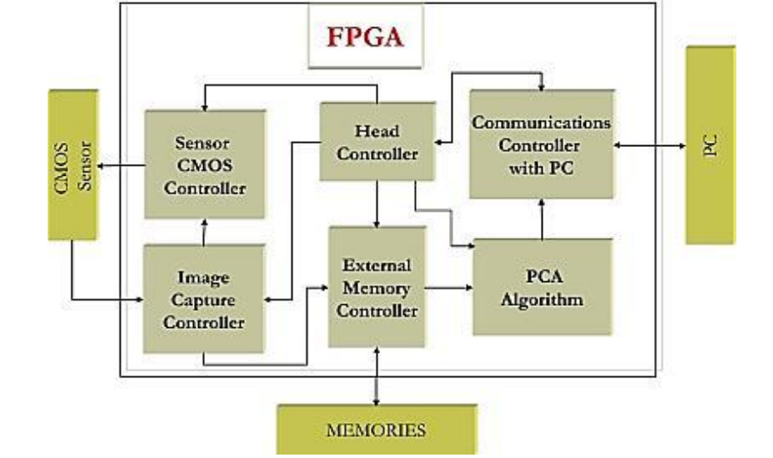
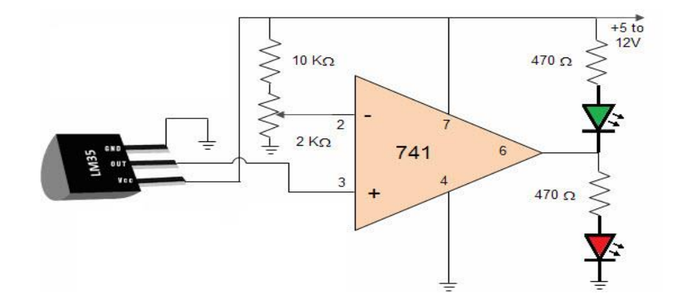
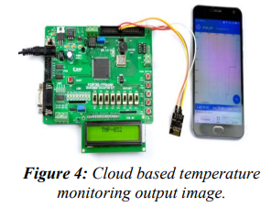
Figure 1: Circuit Diagram[1]
Figure 3:Block diagram of FPGA[1]
Figure 2: Cloud-based temperature monitoring output image[2]

Slide 7

Evaluation and Testing
1
Efficacy and Efficiency
2
Rigorous Testing
Evaluate the efficacy and efficiency of the developed system in terms of real-time temperature monitoring, scalability, compatibility, and performance.
Conduct rigorous testing to validate the reliability and accuracy of temperature measurements under various environmental conditions.
3
Parameter Fine-Tuning
Fine-tune system parameters and functionalities based on testing results and feedback.

Slide 8

Results and Outputs
Challenges Faced
Technology Paradigm
The IOT-based embedded system has faced many challenges in difficult IOT applications. The Field Programmable Gate array structure is the alternate arrangement to overcome the problem that is faced in ARM processors.
In this paper, we have introduced the study of the technology paradigm for IOTs on the FPGA Platform. The IOT-based FPGA includes communication protocols, Data Acquisition and controlling systems.
Temperature Monitoring
The temperature has been monitored with the combination of IOT and FPGA architecture and for every second period the temperature has been updated in the particular IP address.

Slide 9



Future Scope
Innovation
Expansion
Research
Explore innovative applications and advancements in cloud-based IoT systems.
Expand the capabilities and reach of cloud-based temperature monitoring systems.
Continue research and development in the field of FPGA-based IoT solutions.

Slide 10
References
1
Rupani, Ajay
2
Kiruba, M.
3
Johnson, A., & Smith, B.
"A Review of FPGA Implementation of Internet of Things." Journal of Analog and Digital Devices, vol. 4, no. 3, 2019, pp. 7-10.
"FPGA Implementation of Automatic Industrial Monitoring System." Journal of Analog and Digital Devices, vol. 4, no. 3, 2019, pp. 7-10.
"Cloud-Based IoT Temperature Monitoring Systems: A Comprehensive Review." Journal of IoT Research, 12(3), 45-62.
4
Chen, C., et al.
5
Wang, D., et al.
"FPGA-based IoT Solutions: Advancements and Challenges." IEEE Transactions on Emerging Technologies, 24(2), 78-91.
"Security Mechanisms for Cloud-Based IoT Systems: A Comparative Study." Journal of Cybersecurity and Privacy, 6(4), 112-129.

